Slide 1

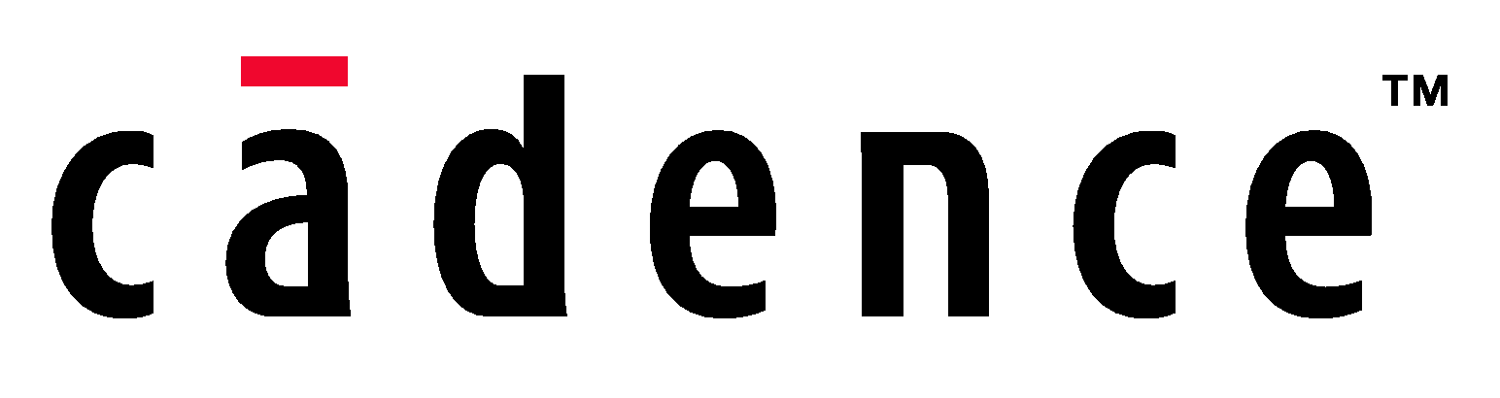
Maximize Vertical Reuse, Building Module to System Verification Environments with UVMe
Horace Chan
PMC-Sierra
Brian Vandegriend
PMC-Sierra
Deepali Joshi
PMC-Sierra
Corey Goss
Cadence

Slide 2
What is vertical reuse?
Horizontal Reuse
Reuse VIP across different projects
Vertical Reuse
Reuse new VIP, sequences, checkers among module, subsystem and system testbenches in the same project
Maximize Vertical Reuse
Import full module testbenches to subsystem testbench
Import full subsystem testbeches to system testbench
Stitch subsystem testcases to create system testcase

Slide 3
Benefits of vertical reuse
Parallel development of all testbenches
Plug-n-play architecture to integrate system level testbench from module and subsystem testbenches seamlessly
Increase verification efficiency
No duplication of development effort
Less testbench code maintenance
Changes in lower level testbench is propagated up automatically
Better debug support from lower level testbench
All lower level testbench the checkers and monitors are available
Easier to move verification engineers among module, subsystems and system level testing

Slide 4
The testbench architecture
200+ Million Gates Design
Partition into 10 subsystems and over 50 modules
Over 20 subsystem and module testbenches
Testbench implemented in Specman UVMe
All VIPs communicate using TLM interface
The system testbench is integrated in 1 month
2-3 days to bring in a new subsystem testbench
Early initial system level testing while subsystem testbench is still finalizing features

Slide 5
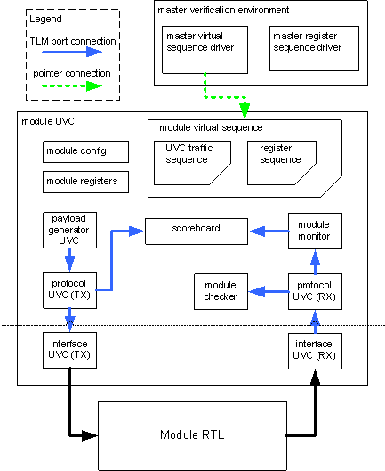
System UVC Architecture
Based on Cadence’s System UVC Architecture
Module UVC
No master virtual sequence or register sequence
UVCs are layered using TLM ports
Separate protocol UVCs from interface UVCs that drive the RTL signals
System UVC is created by putting together multiple module UVCs

Slide 6
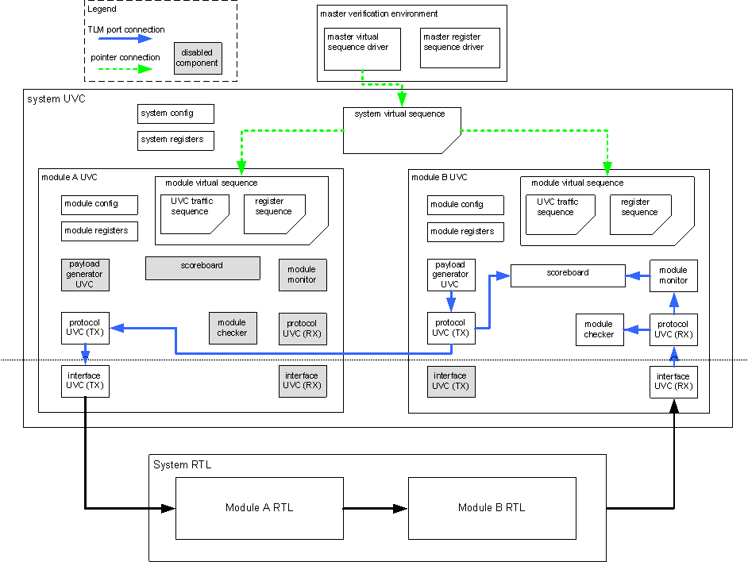
System UVC Example

Slide 7
TLM port router
TLM port limitations:
TLM transport port does not support one-to-many binding
TLM analysis port always broadcast
Port binding is static in the simulation
Solution: TLM port router to support dynamic many-to-many port binding with build-in routing table
// sample implementation of TLM analysis port router
template unit port_router_u of (<type>) {
in_ports : list of in interface_port of tlm_analysis
of <type> is instance;
out_ports : list of out interface_port of tlm_analysis
of <type> is instance;
get_channel_id(tr : <type>) : uint is {};
set_channel_id(tr : <type>, cid : uint) is {}
routing_table : list of src_route_table_entry_s;
};
struct dest_route_table_entry_s {
enable : bool;
port_id : uint;
channel_id : uint;
};
struct src_route_table_entry_s {
enable : bool;
port_id : uint;
channel_id : uint;
destinations : list of dest_route_table_entry_s;
};

Slide 8
Common UVC Configuration Control
Unify data structure to control TLM port binding in module UVC
Enable/disable each individual UVC, checker, scoreboard inside the module UVC
Preserve all the binding information of the module UVC in system UVC
// sample common config control data structure definition
struct config_ctrl_s {
layer_name : layer_t;
enable : bool;
is_active : uvm_active_passive_t;
bind_enable : bool;
};
struct port_config_ctrl_s {
port_name : port_t;
layer_config : list of config_ctrl_s;
};
extend uvm_env {
config_ctrl_table : list of port_config_ctrl_s;
get_uvc_enable(port:port_t, layer:layer_t) : bool is {};
get_uvc_is_active(port:port_t, layer:layer_t)
: uvm_active_passive_t is {};
get_uvc_bind_enable(port:port_t, layer:layer_t)
: uvm_active_passive_t is {};
};

Slide 9
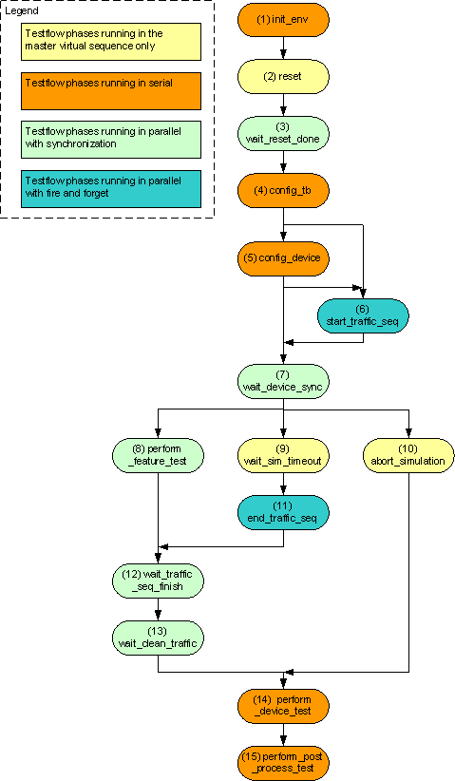
Common Test Flow Virtual Sequence
Testflow to co-ordinate and synchronize the behavior of imported module UVCs virtual sequences
Testflow phases are implemented as empty TCM methods in the virtual sequence base class
Module UVC fill in testflow phases using extension

Slide 10
Benefits and results
Statistic Measure | Previous Project | Current Project | Changes
Gates count | 60M | 200M | +133%
Total lines of code | 575k | 484k | -16%
System testbench line of code | 324k | 215k | -34%
% system testbench in total code | 56% | 44% | -22%
Gates verified per line of code | 104k | 413k | +400%
Less code, less bugs
More reuse, higher quality of the code
System level testcase as short as 20 lines of code
Better system level debug support from subsystem and module level verification engineers

Slide 11
Challenges and Solutions
Revision conflict of common VIP used by the testbenches
Solution:
Freeze common VIP revision early
Make sure new revision is backward compatible
Co-ordinate upgrade of non-backward compatible VIP revision across all testbenches
Poor quality code imported from lower level testbench impact simulation performance
Solution:
All testbenches should run profiling to identify CPU and memory bottleneck
Frequent code review by experienced engineers

Slide 12
Future development
Port the framework to SystemVerilog UVM
SV does not support Aspect Oriented Programming (AOP)
Possible to work around using design patterns
More lines of code and complex TB structure
More upfront planning for hooks and APIs
More intrusive code maintenance
More revision control discipline
e constructs used in the framework
e template -> SV parameterized type
e keyed list -> SV associate array
e predefined routines -> SV macro-based util libraries

